Slide 1

Salary & Experience Across Global Industries
An Analysis of Career Trajectories:
DEEPA.G

Slide 2
AGENDA
Data Cleaning and Preprocessing
Dashboard Creation in Excel.
SQL Query

Slide 3
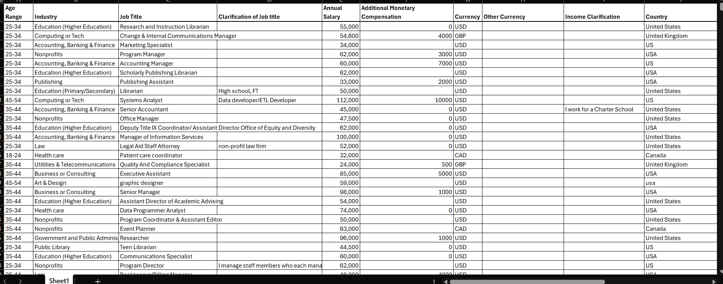
Raw Data
Problems in Raw Dataset
Inconsistent formatting in fields like Gender, Country, and Experience.
Missing values in "Additional Compensation" and "Clarification of Job Title".
Mixed formats (e.g., “US”, “USA”, “United States”).
Extra whitespace in text columns.
Salary columns not always numeric.

Slide 4
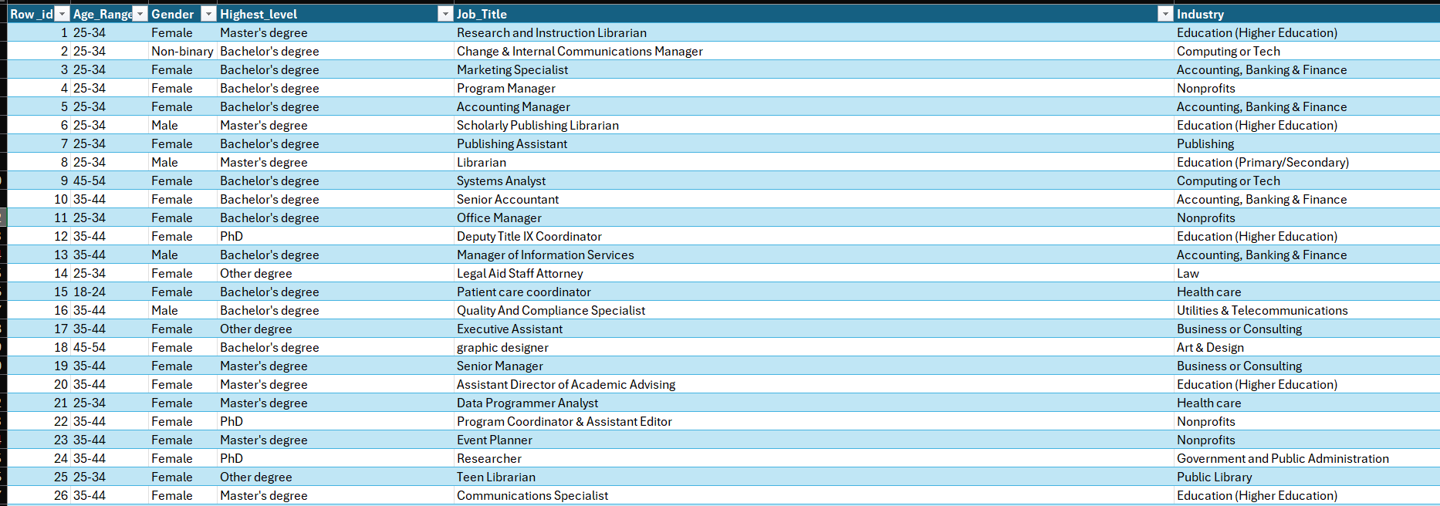
Cleaned Data
Standardized column names
Filled missing compensation with 0 where applicable.
Trimmed all extra spaces in text fields.
Normalized values (e.g., gender to consistent labels).
Converted Salary and Compensation columns to numeric.

Slide 5
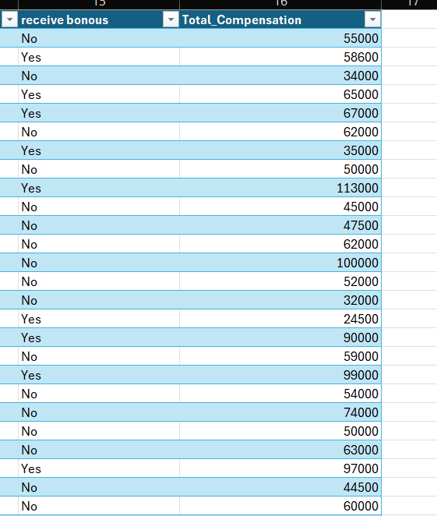
Category Overview
Additional columns
Age Group
Industry
Job_Title
Annual_Salary
Bonus
Currency
Country
State
City
Total_Experience
Field_Experience
Education Level
Gender
Receive bonus:
IF([@bonous]> 0, "Yes", "No")
Total compensation:
[@[Annual_Salary]]+[@bonous]

Slide 6
Objective
Analyze salary trends based on:
Age Range
Gender
Education
Job Title & Industry
Country
Years of Experience
Identify:
High-paying roles/industries
Salary disparity by gender or Country
Bonus trends

Slide 7
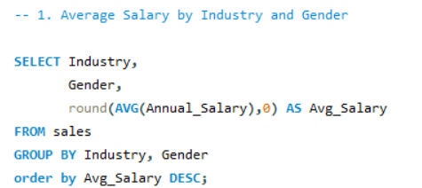
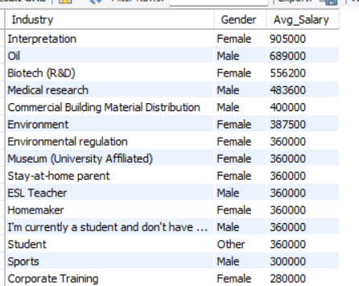
1. Average Salary by Industry and Gender

Slide 8
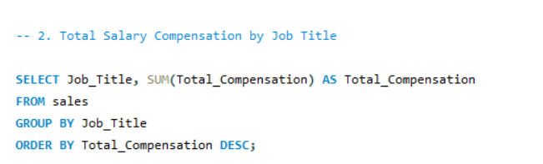
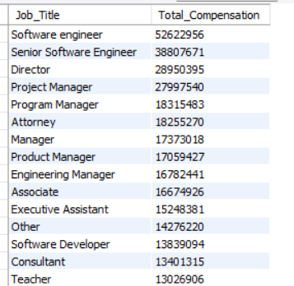
2. Total Salary Compensation by Job Title

Slide 9
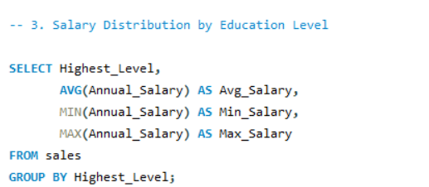
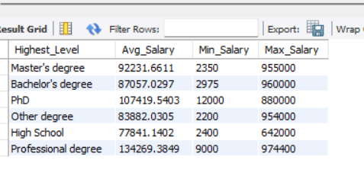
3. Salary Distribution by Education Level

Slide 10
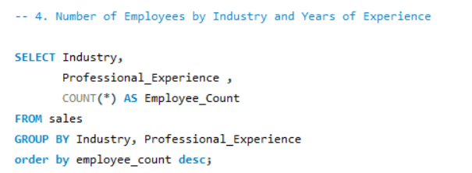
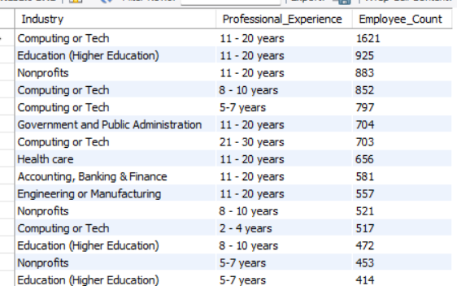
4. Number of Employees by Industry and Years of Experience

Slide 11
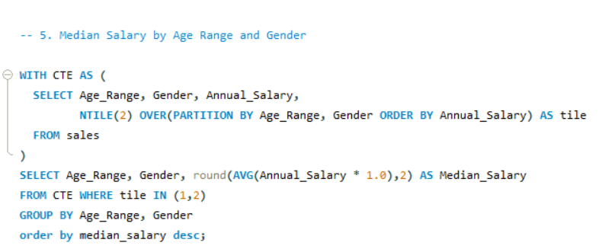
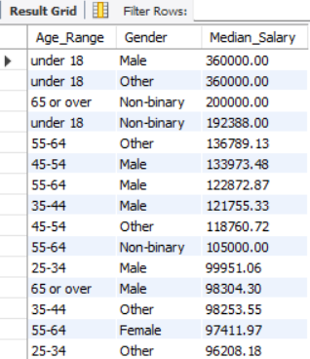
5. Median Salary by Age Range and Gender

Slide 12
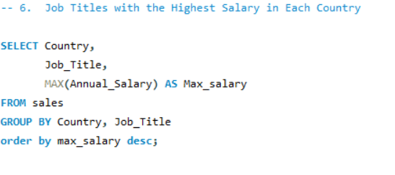
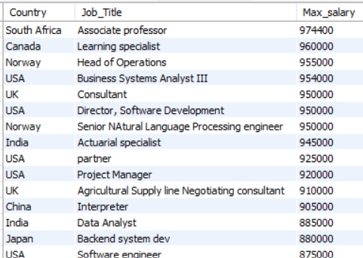
6. Job Titles with the Highest Salary in Each Country

Slide 13
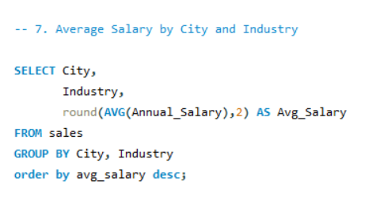
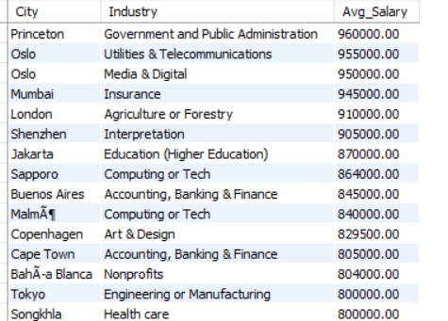
7. Average Salary by City and Industry

Slide 14
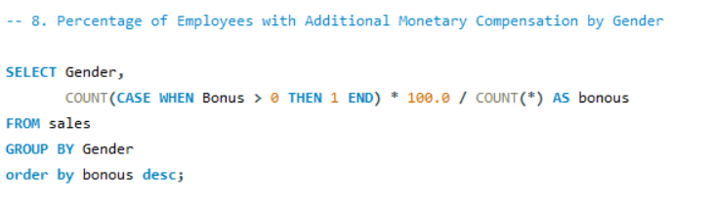
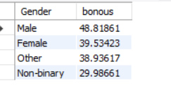
8. Percentage of Employees with Additional Monetary Compensation by Gender

Slide 15
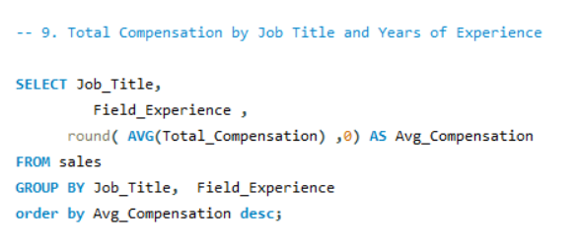
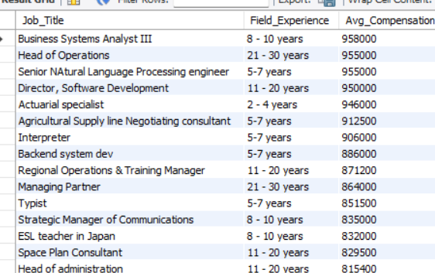
9. Total Compensation by Job Title and Years of Experience

Slide 16
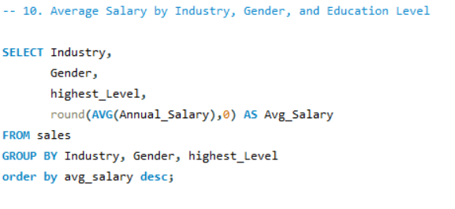
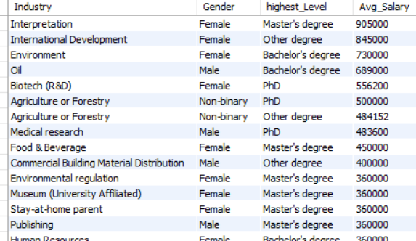
10. Average Salary by Industry, Gender, and Education Level

Slide 17
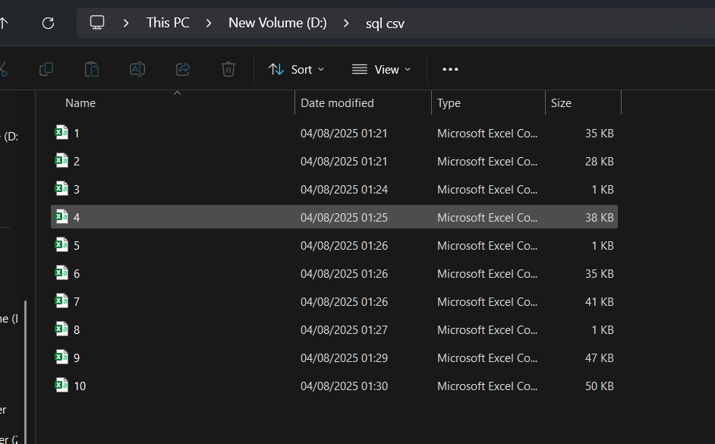
Convert SQL query to CSV

Slide 18
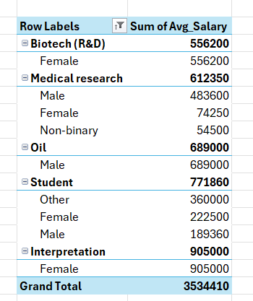
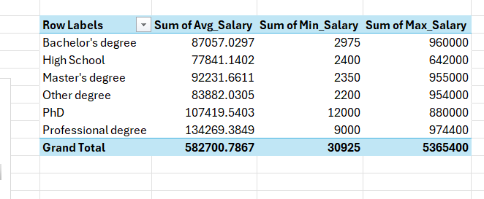
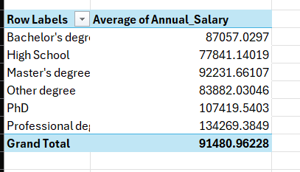
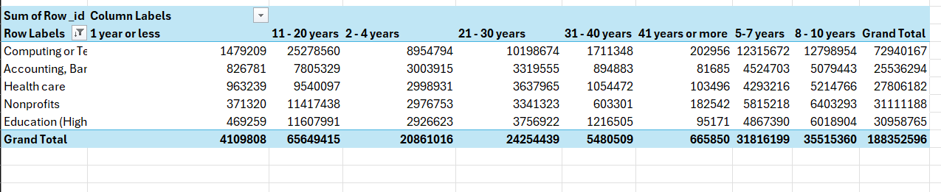
Pivot Tables

Slide 19

KPI
1. Industry with highest Salary
2. Total employee
Education (Higher Education)
28103
3. Max of Annual_Salary
4. Country with highest salary
974400
South Africa
5. Highest salary by gender
7. Employees With Bonus
6. Highest paid education level
Male
Bachelor's degree
11547

Slide 20
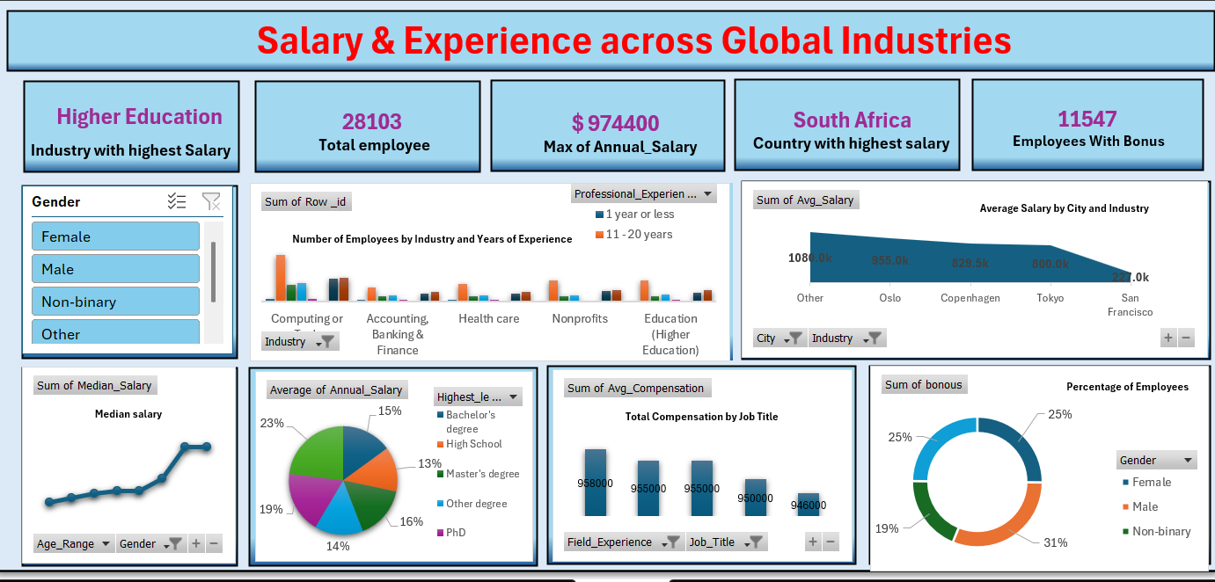
Dashboard

Slide 21
Key Insights:
1. Top Performers
Highest Paying Industry: Higher Education offers the highest salary.
Highest Annual Salary: $974,400.
Top Country by Salary: South Africa.
City with Highest Average Salary: "Other" cities (likely outliers or uncategorized) followed by Oslo
Total Employees: 28,103.
Employees Receiving Bonus: 11,547 (~41%).
Gender Distribution: Balanced representation across Female, Male, Non-binary, and Others.
Bonus Distribution by Gender:
Male: 31%
Female: 25%
Non-binary: 19%
2. Experience & Compensation
Employees with 11-20 Years Experience have a significantly higher presence across industries.
3. Education Impact
PhD holders and Master’s graduates dominate higher salary brackets.
Bachelor's and Master's degree holders make up the majority of high average salary contributors.
4. Job Role Compensation
Top paying roles (close to $958,000) are in Field Experience and certain Job Titles, showing clear value of domain expertise.

Slide 22
Recommendations:
Focus on Higher Education Industry – It offers the highest salaries.
Gain More Experience – Employees with 11–20 years of experience earn more.
Encourage Education – Employees with Master’s or PhD degrees earn higher average salaries.
Support Gender Equality – Ensure bonuses are fairly distributed among all genders.
Use High-Salary Cities – Target cities like Oslo for better job opportunities or talent sourcing.
Reward Skill-Based Roles – Job titles with field experience get better compensation—encourage skill development.
Track Median Salary by Age – Salaries grow with age; retain experienced employees.
Increase Bonus Coverage – Only 41% of employees receive bonuses—expand bonus programs.

Slide 23


